Slide 1

Neural Networks
Session 2 & 3: Perceptron

Slide 2
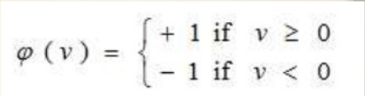
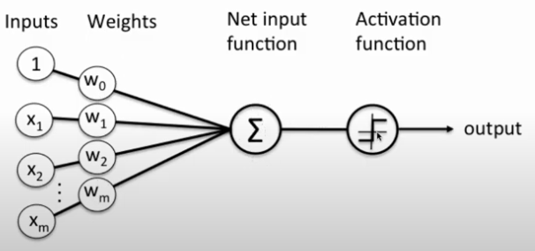
Introduction
The perceptron was first proposed by Rosenblatt (1958) is a simple neuron that is used to classify its input into one of two categories.
A perceptron is a single processing unit of a neural network. A perceptron uses a step function that returns +1 if weighted sum of its input ≥ 0 or -1 otherwise

Slide 3
What is Perceptron?
The perceptron is an algorithm for supervised learning of binary classifiers. A binary classifier is a function which can decide whether or not an input, represented by a vector of numbers, belongs to some specific class.

Slide 4
Limitations
The perceptron can only model linearly separable functions, those functions which can be drawn in 2 D graph and single straight line separates values in two part.
Boolean functions below are linearly separable
AND
OR
NOT (Complement)
It cannot model XOR functions as it is non linearly separable. When the two classes are not linearly separable, it may be desirable to obtain a linear separator that minimizes the mean squared error.

Slide 5
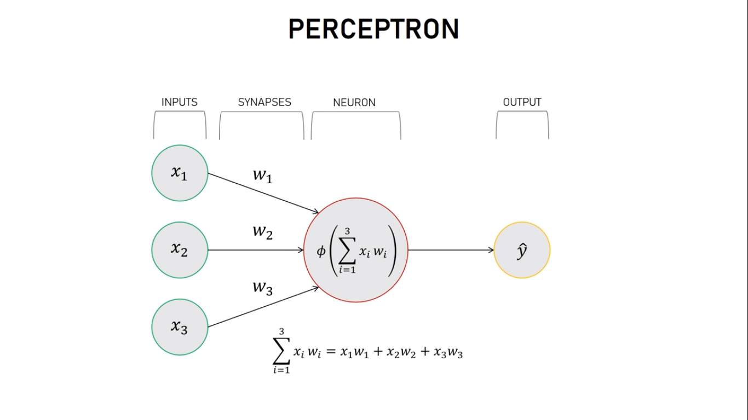

Slide 6
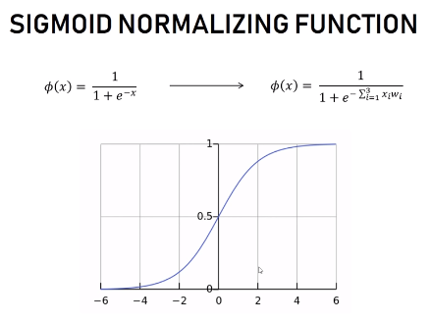

Slide 7
Types of Perceptron
Single Layer Perceptron
Multi Layer Perceptron

Slide 8
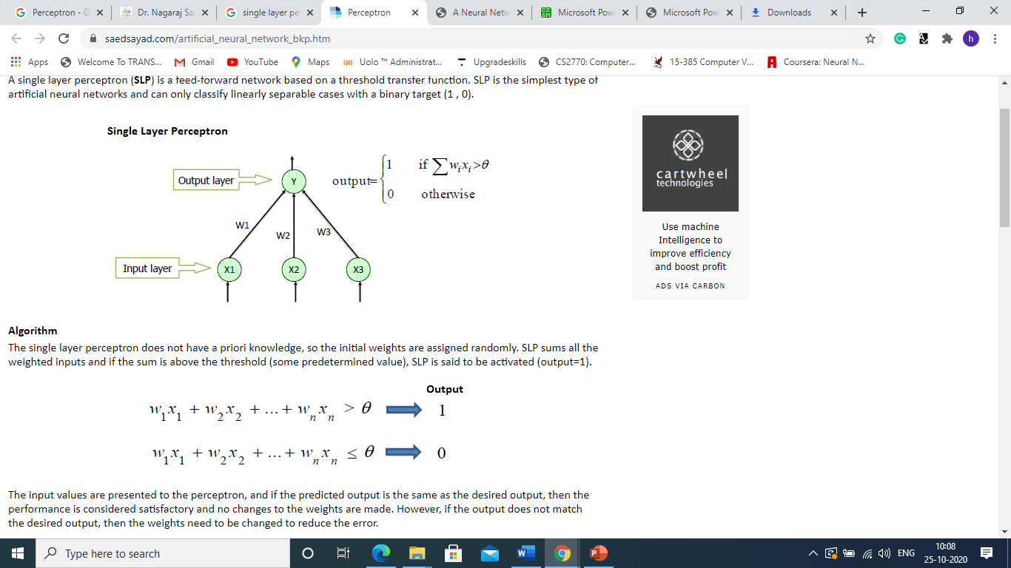
Single Layer Perceptron
A single layer perceptron (SLP) is a feed-forward network based on a threshold transfer function. SLP is the simplest type of artificial neural networks and can only classify linearly separable cases with a binary target (1 , 0).

Slide 9
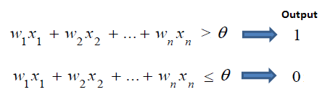
Algorithm
The single layer perceptron does not have a prior knowledge, so the initial weights are assigned randomly. SLP sums all the weighted inputs and if the sum is above the threshold (some predetermined value), SLP is said to be activated (output=1).

Slide 10
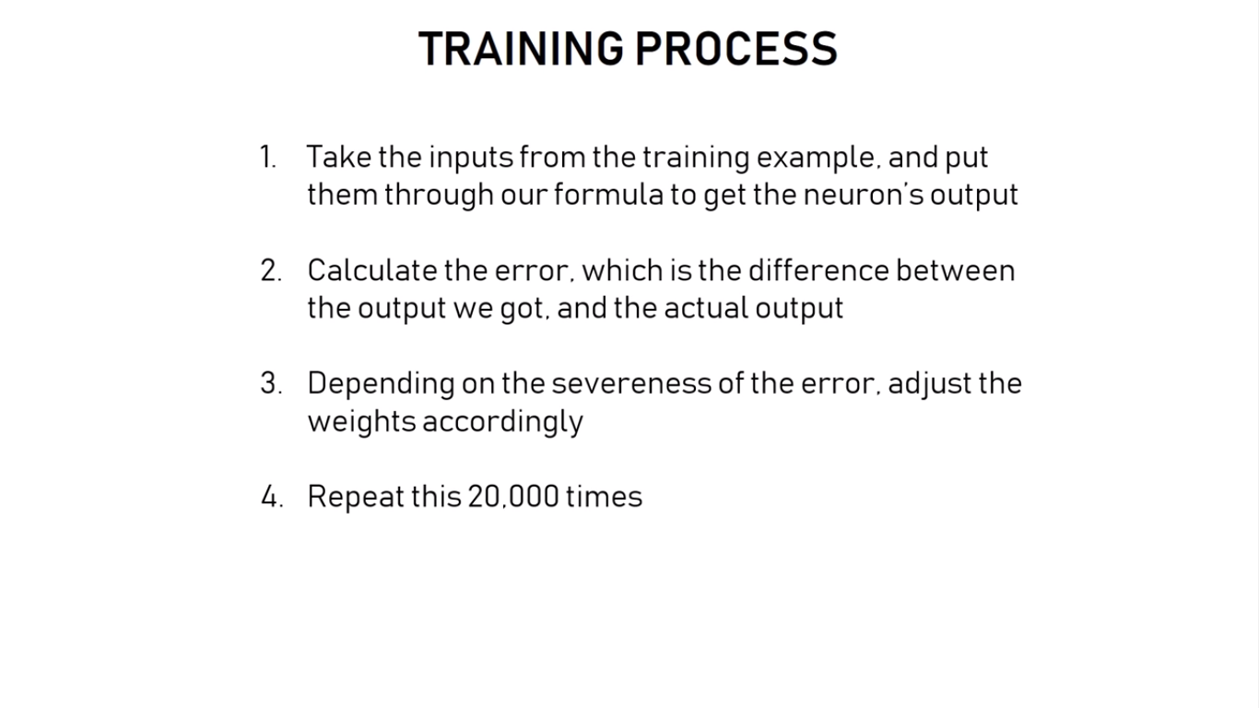

Slide 11
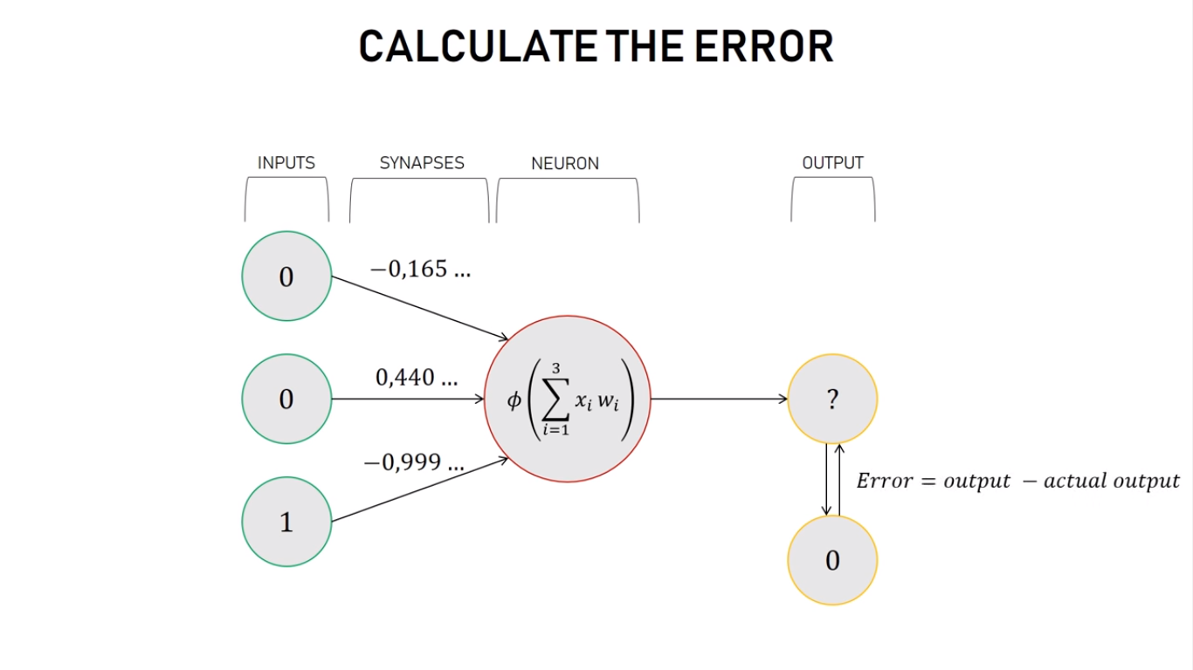

Slide 12
Formulas
Update Weight
W_{i}(new) = W(old) + alpha * target * X_{i}
Update Bias
b(new) = b(old)+alpha * target
Notations:
W- weight
Alpha – learning rate
X –input
Target – actual output
b - Bias
The input values are presented to the perceptron, and if the predicted output is the same as the desired output, then the performance is considered satisfactory and no changes to the weights are made. However, if the output does not match the desired output, then the weights need to be changed to reduce the error.

Slide 13
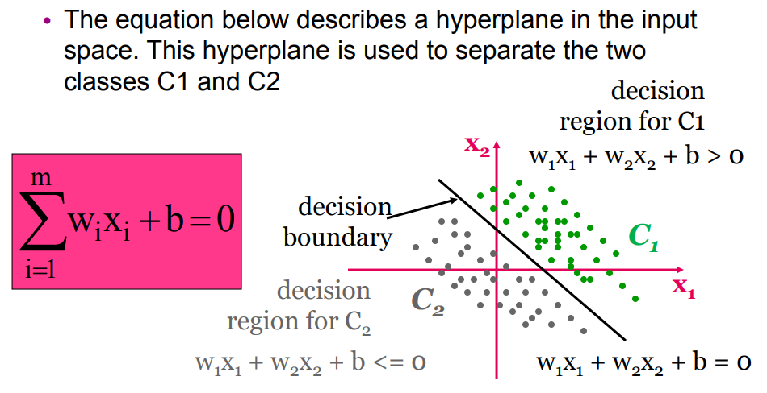
Perceptron : Classification (disease Diagnosis)

Slide 14
Multi-layer Perceptron - Backpropagation algorithm
A multi-layer perceptron (MLP) has the same structure of a single layer perceptron with one or more hidden layers. The backpropagation algorithm consists of two phases: the forward phase where the activations are propagated from the input to the output layer, and the backward phase, where the error between the observed actual and the requested nominal value in the output layer is propagated backwards in order to modify the weights and bias values.

Slide 15
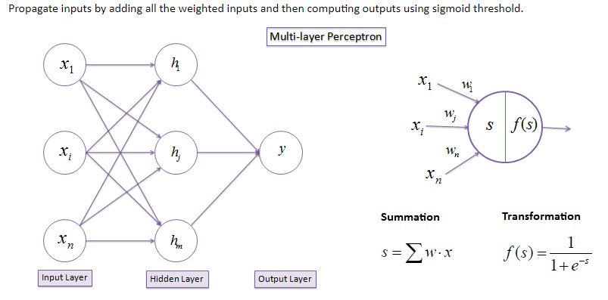
Forward Propagation

Slide 16
Multilayer Neural Network training (in Health care Industry)
x1
Hidden Layer 1
w11
f11
Hidden Layer 2
O11
w12
w13
f21
Output Layer
x2
O21
f12
O12
f31
Ỹ
f22
x3
f13
O22
Loss Function = (y - Ỹ)²
y – Actual Output
Ỹ - Predicted Output
Objective: Loss must be reduced, for that we need optimizer (Gradient Descent)
O13
x4

Slide 17
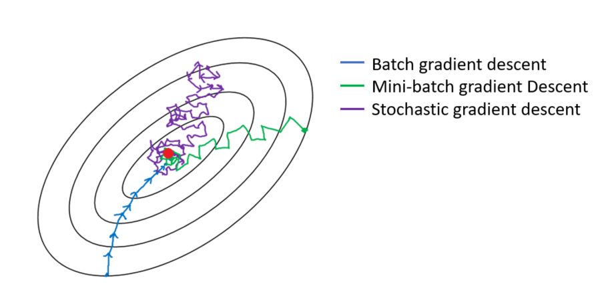
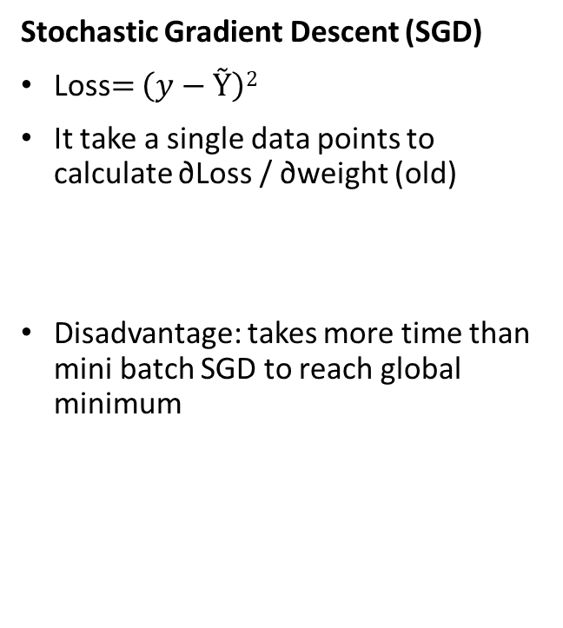
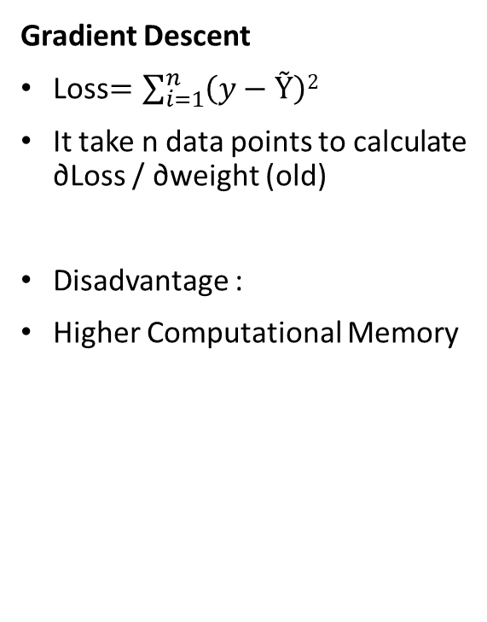
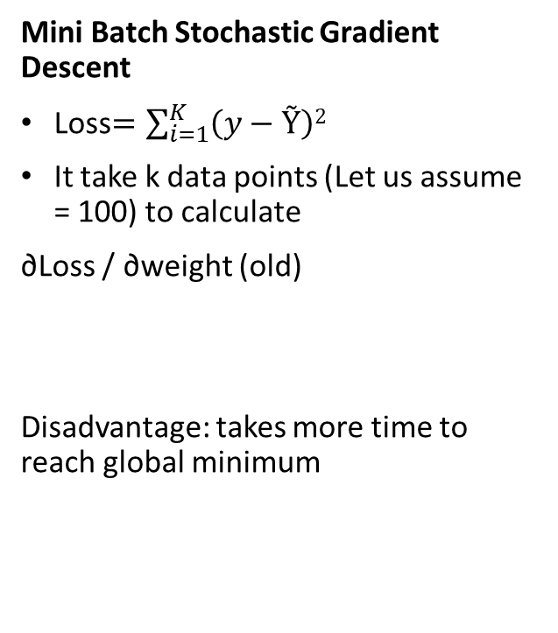
Optimizer
Stochastic Gradient Descent (SGD)
Loss$=$ $\left(y−Ỹ\right)2$
It take a single data points to calculate ∂Loss / ∂weight (old)
Disadvantage: takes more time than mini batch SGD to reach global minimum
Mini Batch Stochastic Gradient Descent
Loss$=\sum_{i=1}^{K}{\left(y−Ỹ\right)2}$
It take k data points (Let us assume = 100) to calculate
∂Loss / ∂weight (old)
Disadvantage: takes more time to reach global minimum
Gradient Descent
Loss$=\sum_{i=1}^{n}{\left(y−Ỹ\right)2}$
It take n data points to calculate ∂Loss / ∂weight (old)
Disadvantage :
Higher Computational Memory
Mini Batch SGD is approximately equal to Gradient Descent

Slide 18
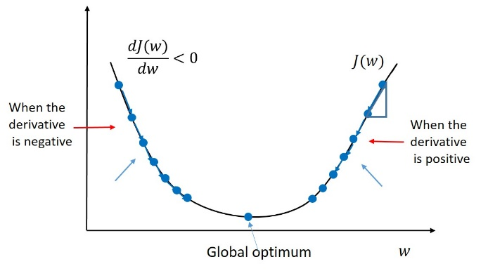
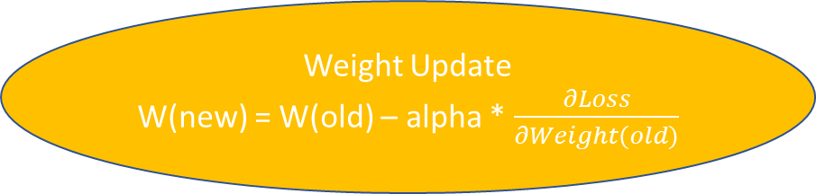
Gradient Descent Optimization
Weight Update
W(new) = W(old) – alpha * $\frac{∂Loss}{∂Weight(old)}$

Slide 19
Classroom Activity1: Problem : Realization of sample data by using the single layer perceptron Algorithm (Bipolar inputs & Targets).
Truth Table
x1 | x2 | B | T
1 | 1 | 1 | 1
1 | -1 | 1 | -1
-1 | 1 | 1 | -1
-1 | -1 | 1 | -1

Slide 20
Hints
Initialize w1 =w2 =0, b = 0, theta = 0, alpha =1
Yin = b+x1w1+x2w2
F (yin) = 1 yin>theta
0 yin =theta
-1 yin < theta
Wi (new) = w(old) + alpha * t*xi
B(new) = b(old) + alpha * t
x1 | x2 | t | yin | y | t | ∆W1 | ∆W2 | ∆b | w1 | w2 | b

Slide 21
X1 = -1, x2 = 1, w1 =0 , w2 = 12 b =0 alpha = 1, theta = 0 yin = w2(new) = w(old) + alpha*t*x1 = 1 b(new) = b(old) + alpha*t = 1
x1 | x2 | t | yin | y | t | ∆W1 | ∆W2 | ∆b | w1 | w2 | b
1 | 1 | 1 | 0 | 0 | 1 | 1 | 1 | 1 | 1 | 1 | 1
1 | -1 | -1 | 1 | 1 | -1 | -1 | 1 | -1 | 0 | 2 | 0
-1 | 1 | -1 | 2 | 1 | -1 | 1 | -1 | -1 | 1 | 1 | -1
-1 | -1 | -1 | -3 | -1 | -1 | 0 | 0 | 0 | 1 | 1 | -1

